Slide 2


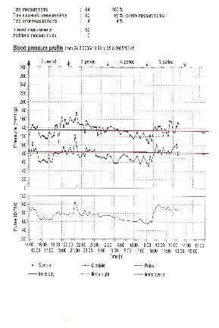
BP thresholds (mmHg) for definition of Hypertension with different types of measurement
 | SBP | DBP
Office or clinic | 140 | 90
Home | 130-135 | 85
24-hour | 125-130 | 80
Day | 130-135 | 85
Night | 120 | 70
Notes:
2

Slide 4
Evaluation of Hypertension
To rule out identifiable and often curable causes of hypertension.
To determine the extent of target organ damage.
To assess the patient's overall cardiovascular risk status.

Slide 5
History
Duration of hypertension
Last known normal blood pressure
Drugs: types, doses, side effects
Intake of agents that may cause hypertension
Family history
Hypertension
Premature cardiovascular disease or death
Familial diseases: pheochromocytoma, renal disease, diabetes

Slide 6
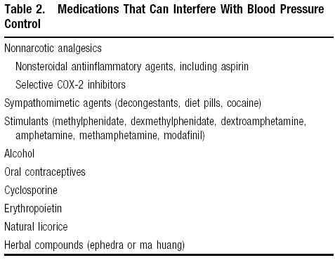

Slide 7
History
Presence of other risk factors
Family history
Age
Smoking
DM
Dyslipidemia
Obesity
Physical inactivity

Slide 8
History
Symptoms of target organ damage
Headaches
Transient weakness or blindness
Loss of visual acuity
Chest pain
Dyspnea
Claudication

Slide 9
History
Symptoms of secondary causes
Muscle weakness
Spells of tachycardia, sweating, tremor
Flank pain
Recent obesity

Slide 10
Physical Exam
General appearance
Distribution of body fat
Skin lesions
Muscle strength
Alertness
Pulse
Funduscopic examination

Slide 12
Target Organ Damage
Heart disease
Left ventricular hypertrophy
Angina or prior myocardial infarction
Prior coronary revascularization
Heart failure
Stroke or transient ischemic attack
Chronic kidney disease
Peripheral arterial disease
Retinopathy

Slide 14
Secondary Hypertension is Suggested By
Severe or refractory hypertension.
An acute rise in blood pressure.
Proven age of onset before puberty.
Age less than 30 years in non-obese patients.
A confirmed negative family history of hypertension.

Slide 15


Slide 16
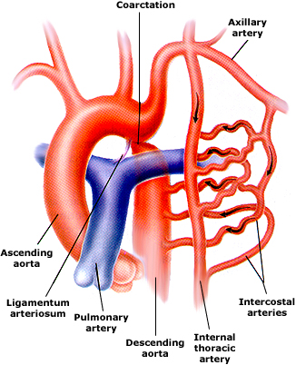

Slide 17
